Slide 1






TEAM SJRK
HIGHSCORE 2500
DEADLINE
CORPORATE SURVIVAL ADVENTURE
TurnIng everyday wellness Into an epic survival quest

Slide 2







01
07
12
WELLNESS AGENDA
WORK QUALITY
PHYSICAL
ACTIVITY
FOOD INTAKE
HRMS DATA
WEARABLES DATA
CAFETERIADATA

Slide 3
01
07
12
PHYSICAL WELLNESS
Survival Resource | Real World Mapping | Example
🔥 Firewood | Daily Steps | Each 1,000 steps = 1 log. Not enough logs → your campfire dies .
🛖 Shelter | Sleep Hours | If avg sleep ≥ 7 hrs → sturdy hut. If < 6 hrs → roof leaks in monsoon.
💧 Water | Meditation | Meditating = filtering water. Stressed team? Water turns muddy, stamina drains faster

Slide 4
01
07
12
HR METRICS
Satisfaction & Evaluations | Gauge morale, personalization AI
Workload & Projects | Burnout risk, challenge fairness
Sentiment & Engagement | Link engagement to wellness behavior
Monthly Performance Metrics | Analyze long-term impact and trends

Slide 5
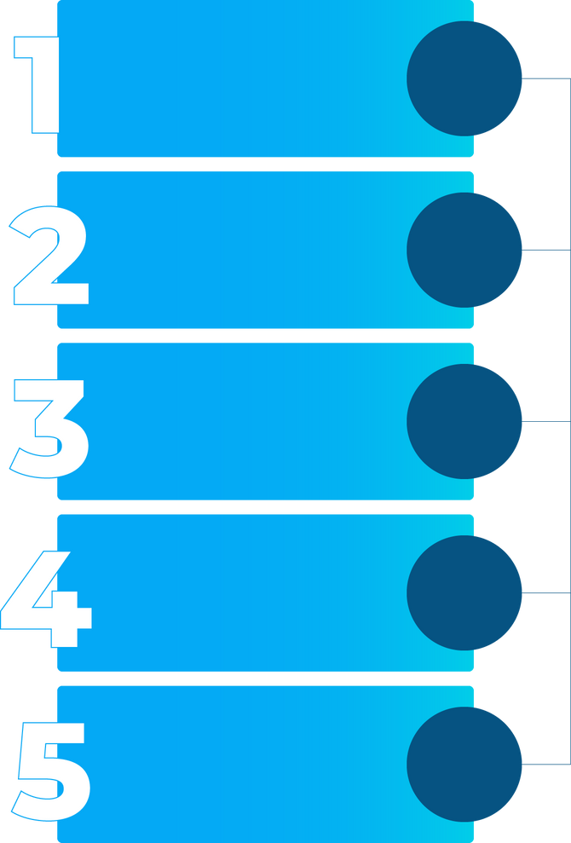
01
07
12
FOOD INTAKE
EMPLOYEE PROFILE & GOAL SETUP
EMPLOYEE INPUTS: HEIGHT, WEIGHT, AGE, GENDER,
SYSTEM CALCULATES BMI → DETERMINES CALORIE GOAL BASED ON TARGET: LOSE / MAINTAIN / GAIN WEIGHT.
MEAL SELECTION CAFETERIA
EMPLOYEE CHOOSES MEALS / COMBOS FROM CAFETERIA
EACH MEAL HAS NUTRITIONAL DATA: CALORIES, PROTEIN, CARBS, FATS, FIBER, MICRONUTRIENTS.
SYSTEM COMPARES MACROS WITH CALORIE GOALS.
SUGGESTS BALANCED ADJUSTMENTS:
“ADD GRILLED CHICKEN TO MEET PROTEIN TARGET.”
NUTRITION ANALYSIS
GAMIFIED MAPPING
HEALTHY MEALS → ENERGY BUFFS (BOOST FIREWOOD)
JUNK/UNBALANCED MEALS → SPOILED FOOD PENALTY (STAMINA DROPS, CAMP WEAKENS).
FEEDBACK LEADER
BOARD
POINTS AWARDED FOR MEETING PERSONAL GOALS.
SCORES CONTRIBUTE TO OVERALL SURVIVAL SCORE & NUTRITION LEADERBOARD.

Slide 6




01
07
12
PERSONALIZED AVATAR

Slide 7

01
07
12
WELLNESS STOCK MARKET
ACTIVITY-BACKED MARKET DYNAMICS:
STOCK PRICES RISE AND FALL BASED ON REAL EMPLOYEE PERFORMANCE (STEPS, CALORIES BURNED, HRV, DIET QUALITY), PLUS MARKET DEMAND. INDIVIDUAL ACHIEVEMENTS = INSIDER SHARES & TEAM GROWTH.
GAMIFIED CORPORATE WELLNESS EXCHANGE
TRANSFORM DEPARTMENTS INTO "COMPANIES" LISTED ON A WELLNESS STOCK MARKET, WHERE TEAM HEALTH, ACTIVITY, AND NUTRITION DRIVE STOCK PRICES. EMPLOYEES TRADE SHARES USING WELLNESS COINS, MERGING FUN WITH FITNESS.
NO FREE RIDERS – EFFORT = TRADING POWER
PERSONAL ACTIVITY UNLOCKS TRADING LIMITS, DIVIDEND ELIGIBILITY, AND LOYALTY BONUSES. EMPLOYEES MUST MOVE, EAT HEALTHY, AND PARTICIPATE TO PROFIT—NO SHORTCUTS.

Slide 8
01
07
12
GAMIFICATION FEATURES
DAILY MISSIONS:
SMALL GOALS LIKE “WALK 5,000 STEPS” OR “MEDITATE 10 MINUTES.”
COMPLETING = POINTS FOR SURVIVAL RESOURCES.
WEEKLY SURVIVAL EPISODES:
EACH WEEK IS A NARRATIVE CHALLENGE: STORMS, WILD ANIMALS, FESTIVALS.
EXAMPLE: “WEEK 2: DROUGHT → EXTRA WATER COLLECTION NEEDED.”
BADGES & AVATAR:
PIXEL BADGES: “ISLAND CHEF,” “STORM SURVIVOR,” “EXPLORER TRIBE.”
PERSONALIZED AVATAR FOR EVERY EMPLOYEE TO GIVE UNIQUE EXPERIENCE

Slide 9
01
07
12
INTERACTIVE DASHBOARDS
TEAM SURVIVAL DASHBOARD:
TRACKS FIREWOOD, SHELTER, WATER, FOOD.
RECOMMENDATION ENGINE FOR CHALLENGE CREATION.
INDIVIDUAL PROGRESS:
PERSONALIZED STATS (BMI, CALORIE GOALS, STEP GOALS)
WEEKLY TRENDS: GRAPHS OF SLEEP STREAKS, FOOD LOGS, & STEPS.
STORYTELLING POP-UPS:
EXAMPLE: “YOUR TRIBE COLLECTED ENOUGH WATER → CAMP THRIVES !”
LANGCHAIN AGENT FOR ENGAGEMENT TRIGGERS.

Slide 10
01
07
12
REWARDS & INCENTIVES
REAL-WORLD REWARDS FOR TEAM WINS:
GIFT CARDS (AMAZON, FLIPKART, STARBUCKS, ETC.)
COUPONS FOR MEALS OR WELLNESS EXPERIENCES
VOUCHERS FOR FITNESS APPS OR SPA SESSIONS
MECHANISM:
TEAMS ACCUMULATE POINTS THROUGH SURVIVAL RESOURCES + PERSONAL GOAL ACHIEVEMENT.
TOP-PERFORMING TEAMS WEEKLY/MONTHLY → REDEEM REWARDS.
EXAMPLE:
“FINANCE TEAM SURVIVED THE STORM AND COLLECTED MAX FIREWOOD → EACH MEMBER GETS A $10 AMAZON VOUCHER!”

Slide 11
TEAM SJRK
HIGHSCORE 2500
DEADLINE
THANK
YOU
SJRK

